Slide 1
LMS method for growth charts
Tim Cole

Slide 2
Constructing growth charts
Weight in 4000 girls aged 1-21
Aim: to define weight distribution at each age
Construct smooth centiles curves
95% below 95th centile
50% below 50th centile
5% below 5th centile

Slide 3
Constructing growth charts
Weight in 4000 girls aged 1-21
Aim: to define weight distribution at each age
Construct smooth centile curves
50% below 50th centile
10% below 10th centile
3% below 3rd centile
etc

Slide 4
LMS method
Cole, JRSS A (1988)
Split into narrow age groups
Summarise skew weight distribution in each group
Power transformation λ, mean μ and coefficient of variation σ
λ μ and σ vary by age

Slide 5
LMS method
Plot λ μ and σ against age and fit smooth curves
L curve for λ
M curve for μ
S curve for σ
Hence LMS method

Slide 6
LMS method
Centile curves are functions of L M and S curves
So if L M and S curves are smooth, centiles are too

Slide 7
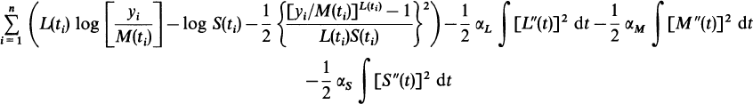

Cole-Green LMS method
Peter Green (1988) proposed using maximum penalized likelihood to improve LMS method
Elegantly avoids arbitrary age groupings
See Cole & Green, Stat Med (1992)
Now the standard method
Peter Green FRS

Slide 8
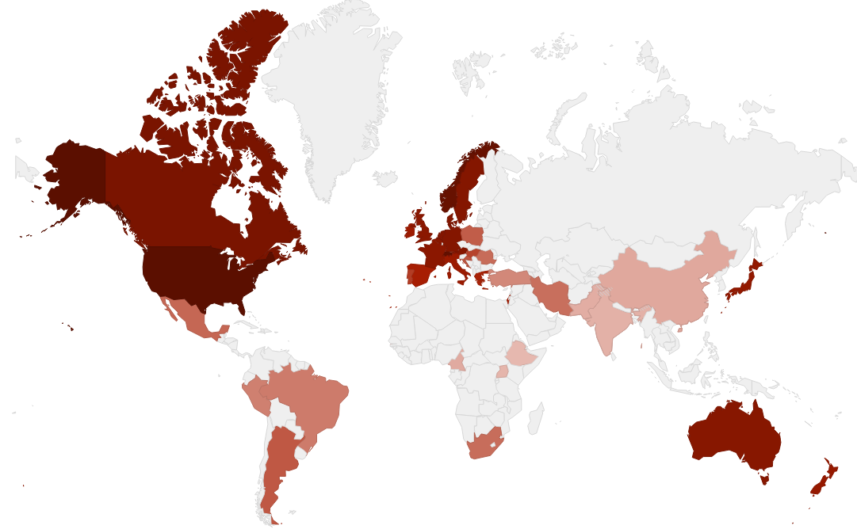
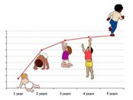
40 countries use LMS method
WHO growth standard

